Slide 1




Instant Weather In Major Cities.
Mustafa gorkem guzeloglu
Sanat Sunil Khare
Ashlesh Prashant Sheth

Slide 2

Contents List
Project Summary
Team Introduction
Timeline
Tools and Programs Used
Web Application

Slide 3
Project Summary
Why is this site used?
What can I find on the site?
Can the site be improved?

Slide 4
Team
Project Manager : Mustafa Gorkem Guzeloglu
Developers and Business Analyst : Sanat Sunil Khare
Data Analyst : Ashlesh Prashant Sheth

Slide 5
Step 1
Step 2
Step 3
Step 4
Present data using HTMl and CSS
Create an API to get data from live cloud database using Mongo DB Realm
Get the data from Weather API
Load data into Python from API

Slide 6

Weather at Major Cities - Parameters
Extracted data from website
Loaded data into python
Data format JSON

Slide 7
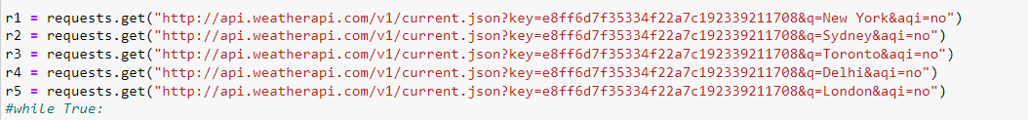
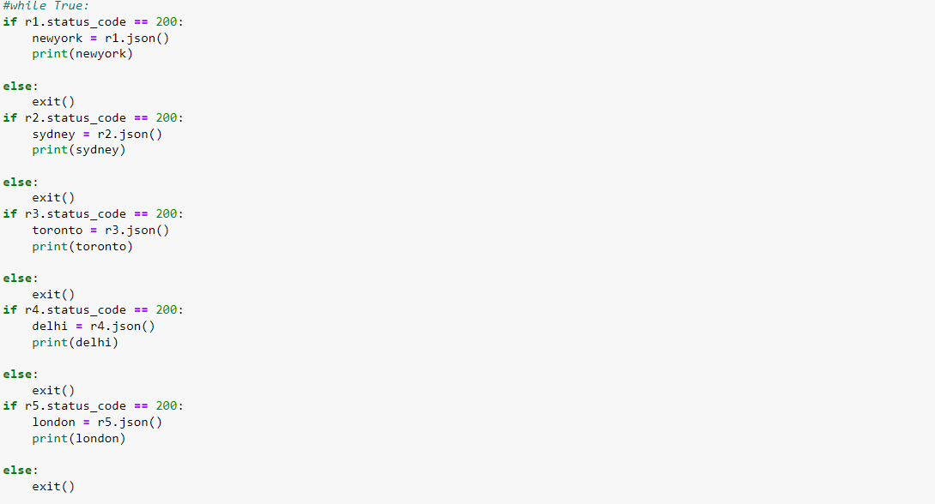
Source and code string we use to get the weather data.

Slide 8
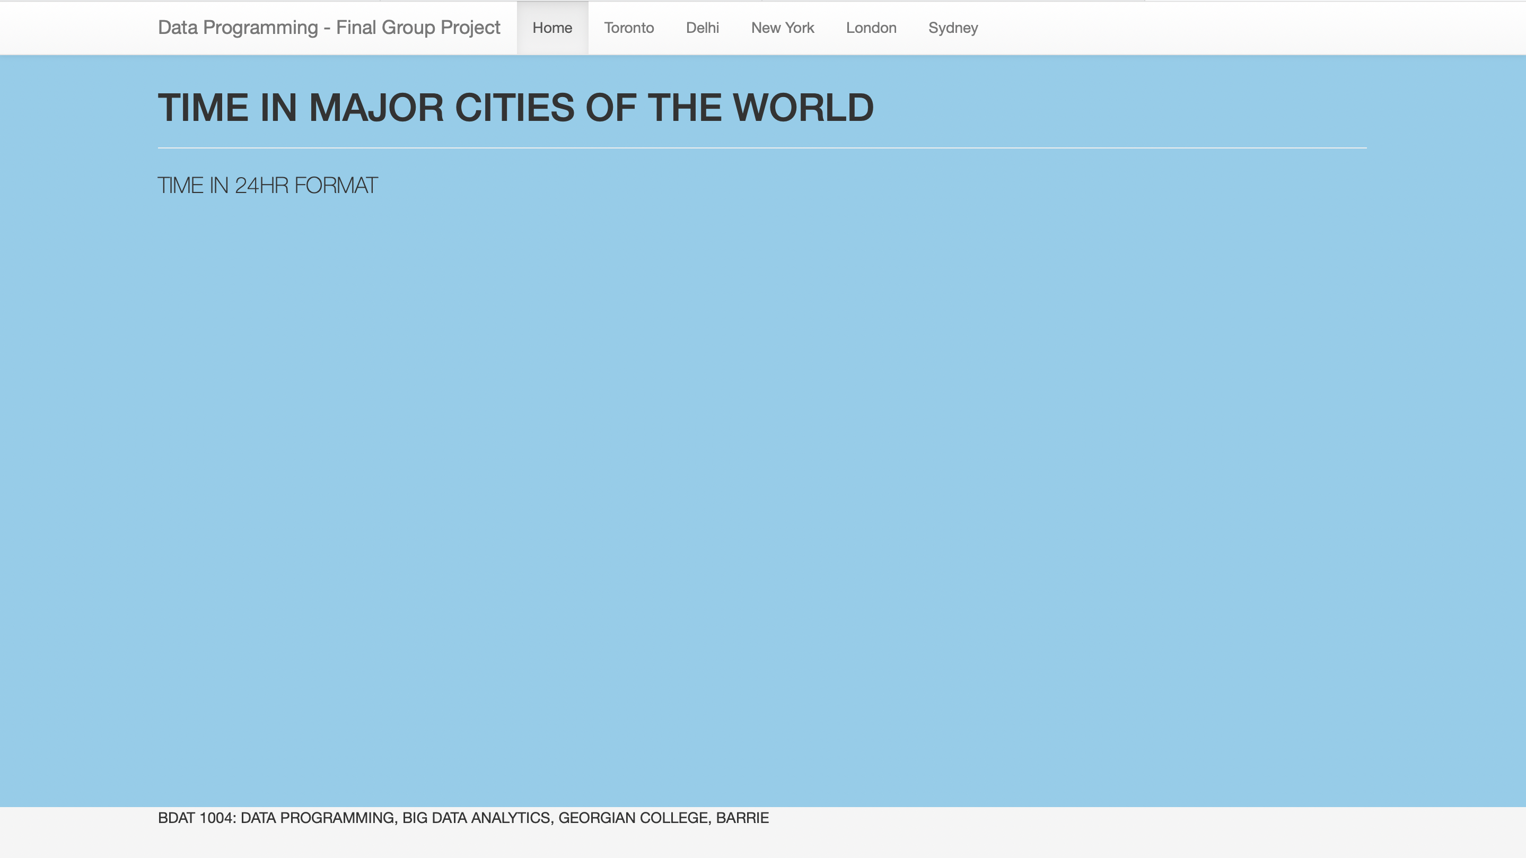
Home page

Slide 9
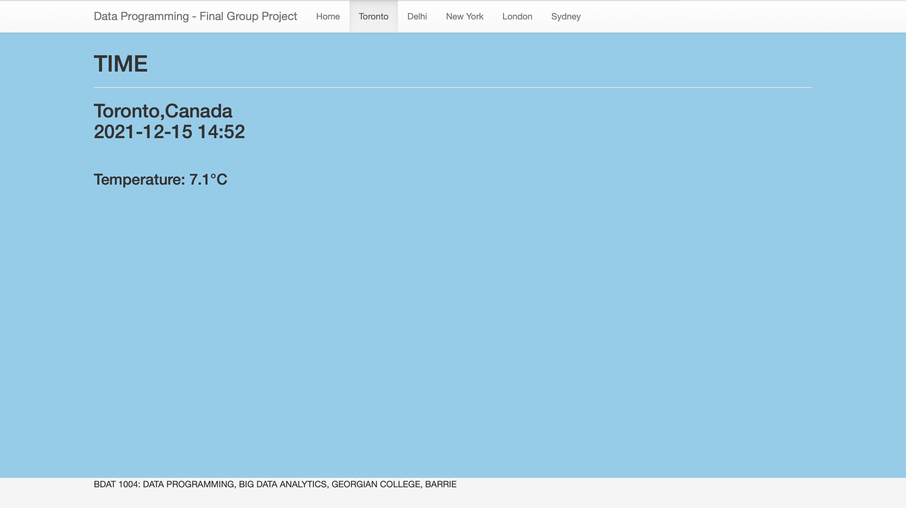
Page showing temperature and time in Toronto

Slide 10
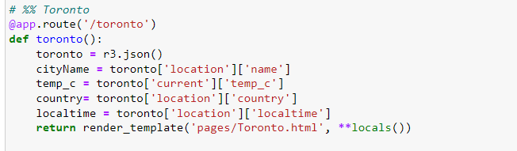

Slide 11
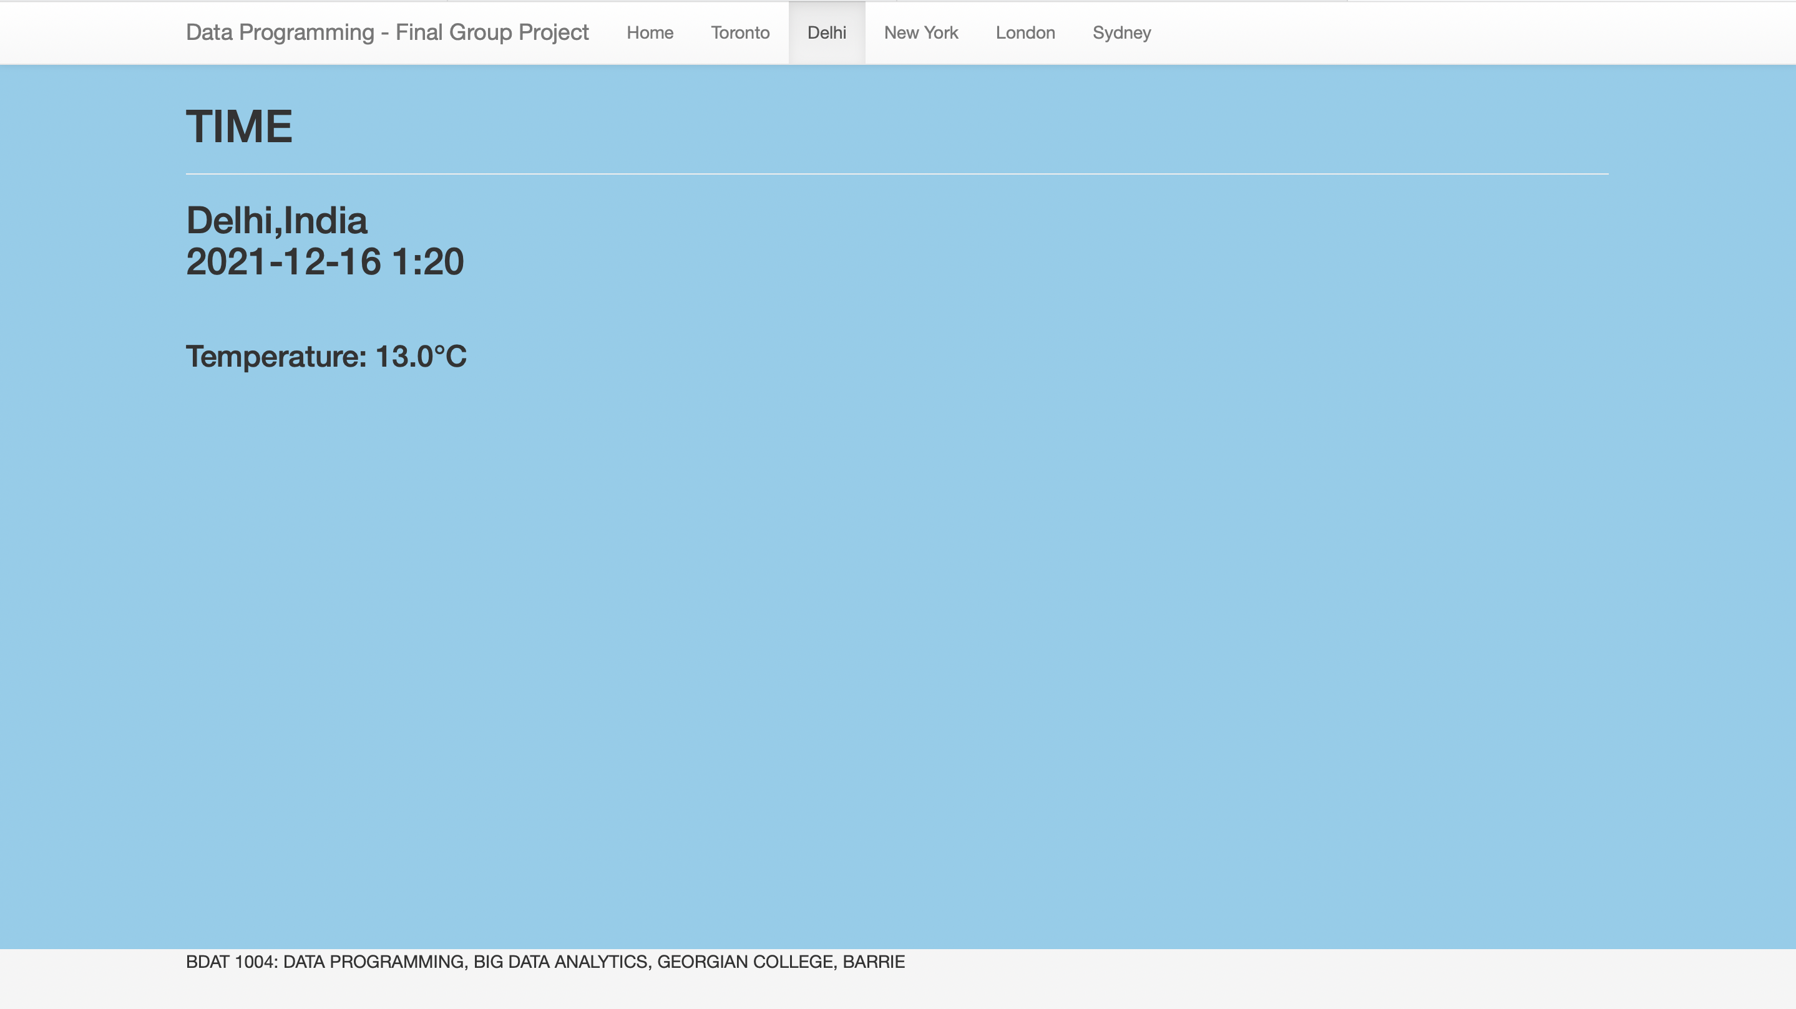
Page showing temperature and time in Delhi

Slide 12
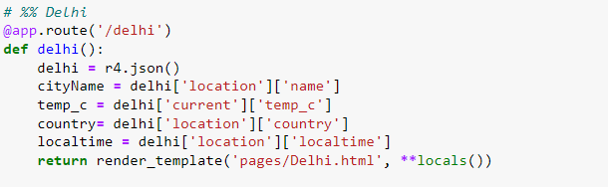

Slide 13
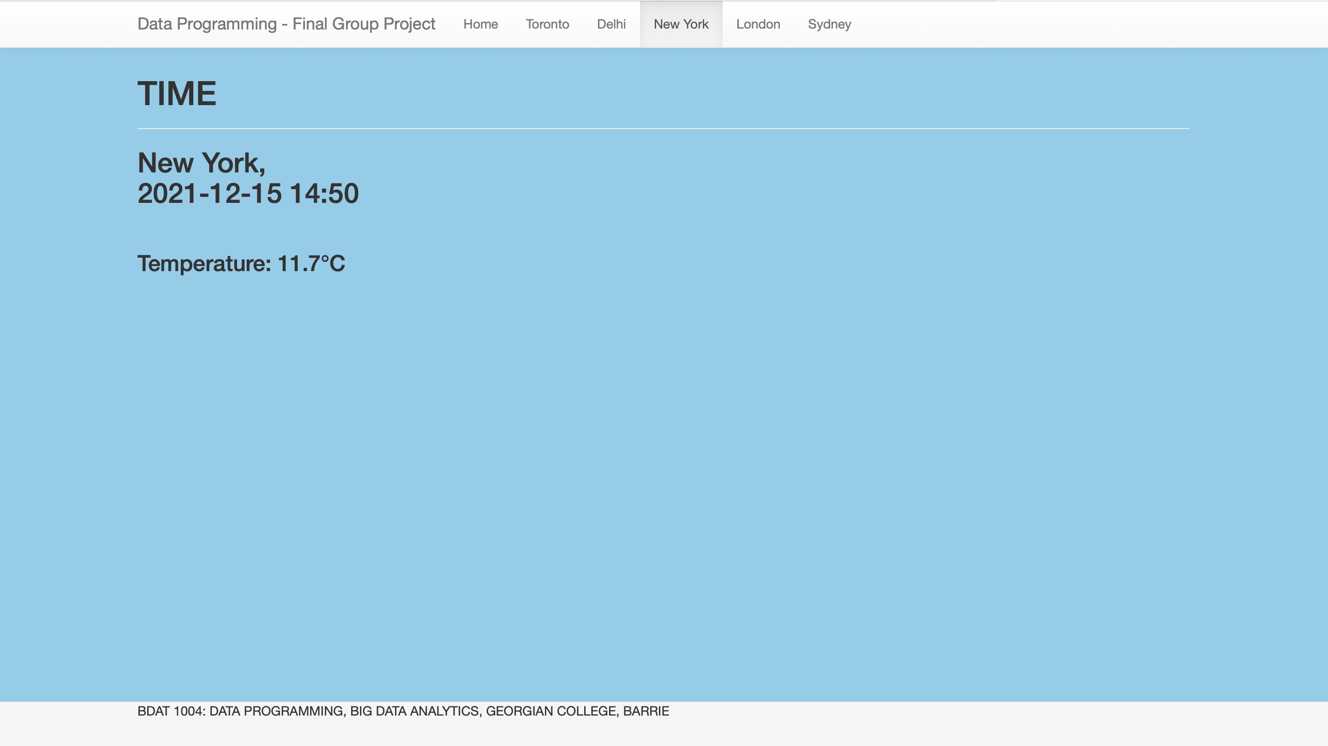
Page showing temperature and time in New York

Slide 14
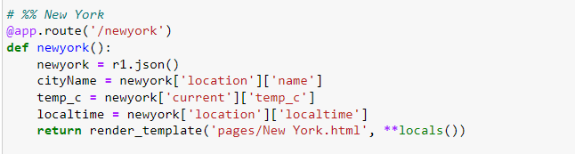

Slide 15
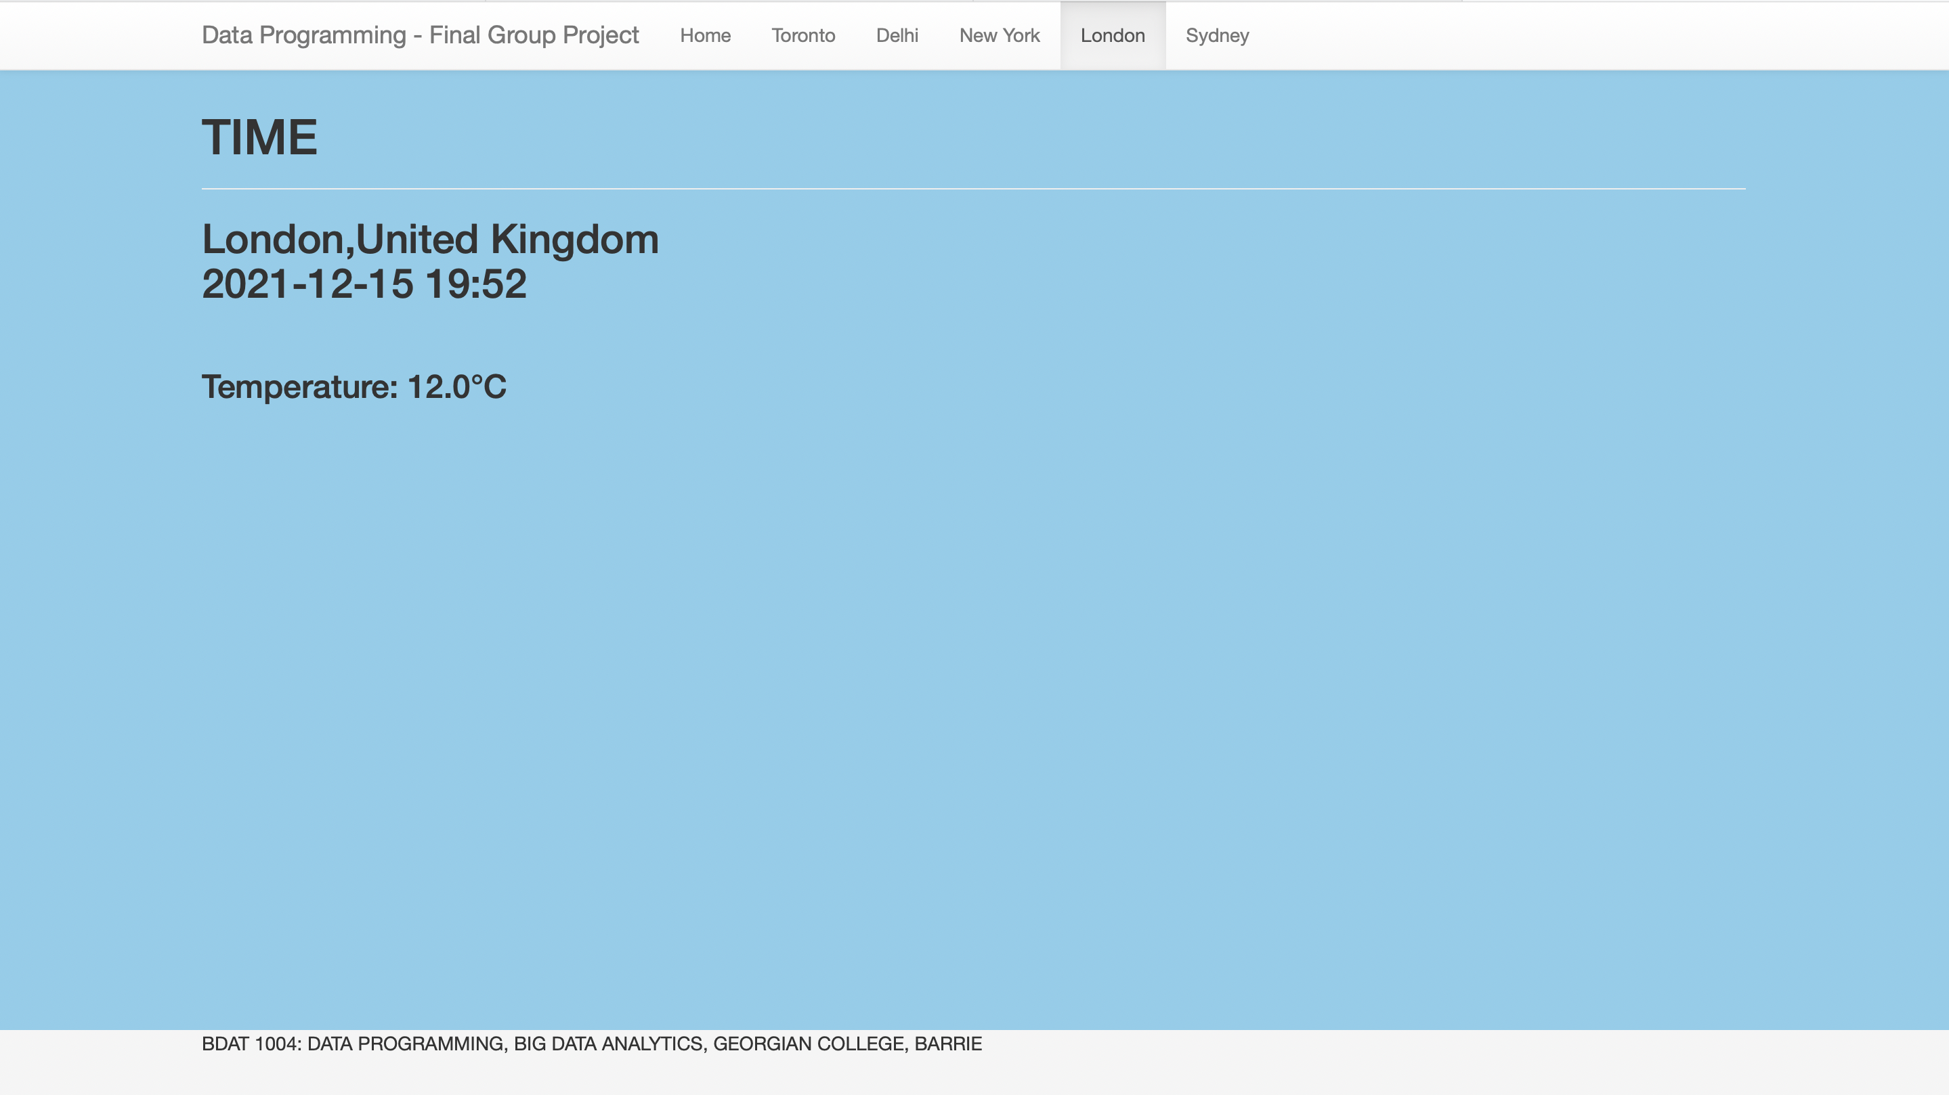
Page showing temperature and time in London

Slide 16
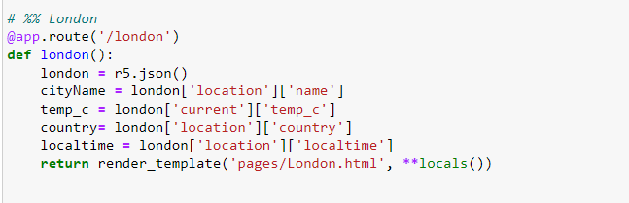

Slide 17
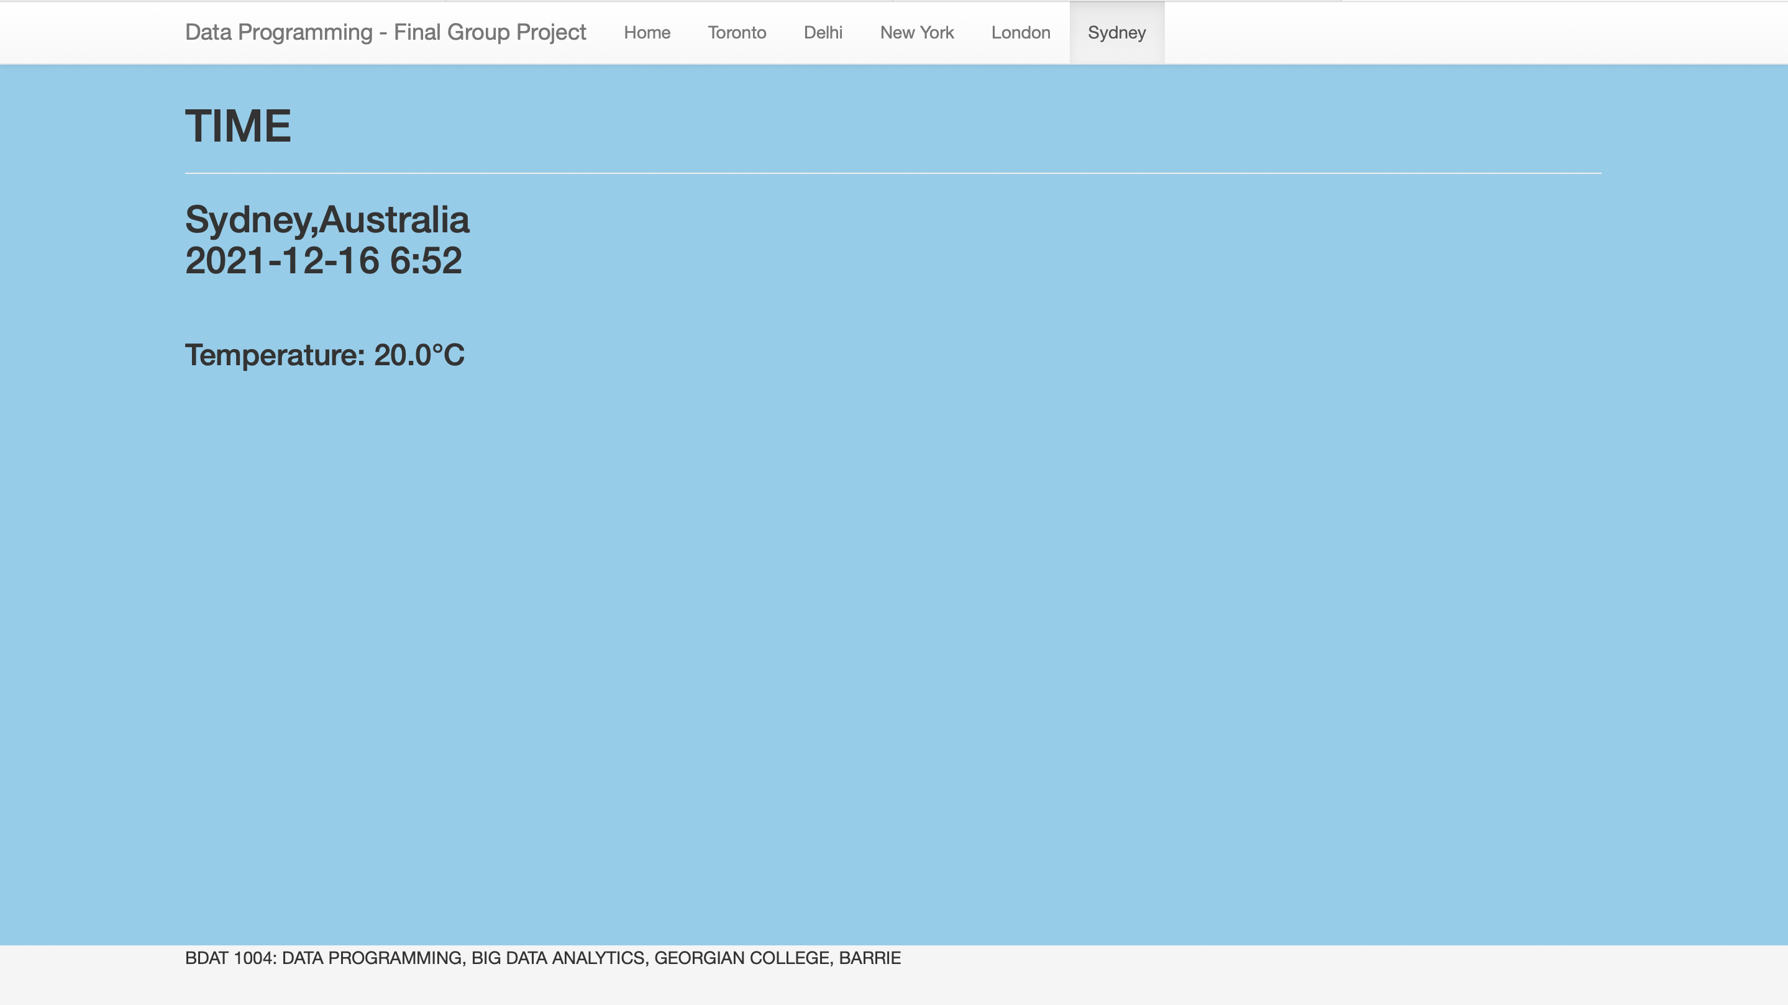
Page showing temperature and time in Delhi Sydney

Slide 18
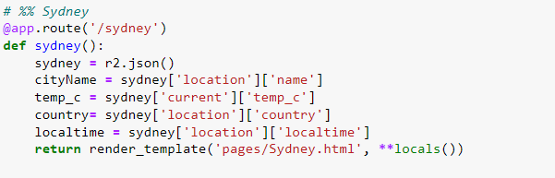

Slide 19



For Web Page Design

Slide 20
We spent a lot of effort to create an API that serves data from a live cloud database but we failed.

Slide 21


